Slide 1

Analyzing Social Media Marketing Strategies of Indonesian E-commerce using Text Mining Techniques
Raretha Maren
Aisyah Larasati
Retno Wulandari
Department of Industrial Engineering
State University of Malang
Notes:
Good Morning everyone, my name is Raretha Maren, I’m from state university of malang Indonesia, in this occasion I would like to do a presentation about my paper, by the title is “Analyzing Social Media Marketing Strategies of Indonesian E-commerce using Text Mining Techniques”

Slide 2
The application of social media has become a core element for many business people in Indonesia as their marketing tools.
Research
Background
Twitter is widely used by business people, such as e-commerce businesses in Indonesia for promoting and advertising.
Blibli Indonesia utilizes Twitter for its social media marketing tools, but Blibli does not implement a proper correct marketing strategy in that platform
Consequently, Blibli has become less recognize by the public in Twitter.
Notes:
The first section started from research background
The application of social media has become a core element for many e-commerce businesses as their marketing tools
One of social media that widely used in Indonesia for promoting and advertising is Twitter.
There are so many e-commerce businesses that use Twitter for doing marketing process. One of that e-commerce is Blibli Indonesia
But, practically, Blibli does not implement the proper marketing strategies that fit with consumer interest
Most of Blibli tweets are yet to have many retweets, so that it makes Blibli become less popular than the other e-commerce.

Slide 3
Research
Objectives
Discovering the preferable tweet contents of Blibli Indonesia’s Twitter through text mining, silhouette method, and k-means clustering
Inventing the best formulation for text clustering problem based on the experiment of 2 parameters
Notes:
So, this study aims to
find the preferable tweet contents of Blibli for doing more targeted marketing that fit with consumer preference through text mining and k-means cluster.
invent the best formulation for text clustering problems based on the experiments

Slide 4

Literature Review
Text Mining
K-Means Clustering
Text mining is the process of finding hidden insights from textual data.
Text mining process involves ML algorithm, linguistics, and statistics to extract the textual data into useful information
In marketing, text mining is applied to discover the preferable contents for proper social media marketing
The task of k-means algorithm is grouping the N data into k class
K-means is a part of partitional clustering, so it needs an optimal k input before executing the algorithm
Silhouette coefficient method can be applied to find best formulation.
Notes:
The second section is literature review
There are two main methods that I used in this study.
The first one is text mining. Text mining is the process of finding new insight from textual data, using ML algorithm, linguistics, and statistics to extract the data into useful information. In marketing, text mining is applied to find the preferable content for implementing the precise social media marketing.
The second one is k-means. The task of k-means is grouping the N data into k class. So, before running the k-means we need the right k input. And for finding the best k to run the k-means properly, we can use silhouette method. Silhouette method is one of metric evaluation for partitional clustering like k-means to find the best quality of clustering result.

Slide 5
Research Methodology
R Studio
Anaconda Environment using Python Modules
Data collection
491 tweets
2 variables (text & retweet count)
Text Preprocessing
Characters & punctuation removal
Case folding
Stemming
Filter stopwords
Tokenizing
Term Weighting
The
K-Means Clustering
The Interpretations
The preferable tweet contents based on average retweets
Silhouette Coefficient Methods
k cluster is ranged from 2-16
Distance measures : cosine & euclidean
Notes:
The third section is methodology
In this study, I used 2 software, namely R Studio for data collection through Twitter crawling process, and Anaconda Environment using Python modules for text preprocessing until interpretations.
The first step is data collection. what we get in data collection is 491 tweets along with 2 variables which are text and retweet count. Text is basically the tweets itself, and retweet count is total retweet in each tweet.
After that, we do text preprocessing. There are so many steps in this stage before entering the clustering process
Characters removal: to remove all characters like emoticon and something like username, digits, and so on.
Case folding: to convert an uppercase letter into lowercase
Stemming: to convert some affixed terms into basic form
Filter stopword: to eliminate meaningless terms
Tokenize: to parse the sentence into a singleton word
Term weighting: to weight all terms into numerical value
These steps are need to be done before entering the clustering process to provide better quality of clustering. Those steps are basically to clean up the data for eliminate some noises in textual data.
After we clean up the data, the next step is to find the best formulation for text clustering using silhouette method. There are 2 experiment in this study, which are k cluster ranged from 2 until 16 & also distance metrics using cosine and Euclidean. From that experiments, we get the best formulation based on the silhouette coefficient for running the k-means properly.
Finally, after doing the clustering process, we can find the most preferable tweet contents that need to be focused by Blibli for doing its marketing strategy in Twitter based on the retweet count variable with the calculation of average retweets in each content cluster.

Slide 6
Results and Discussion
3
1. Discovering the Optimal Cluster with Silhouette Method
The Number of Cluster (k) | Silhouette Coefficient with Cosine Distance | Silhouette Coefficient with Euclidean Distance
2 | 0,0634 | 0,0368
3 | 0,0794 | 0,0463
4 | 0,0941 | 0,0542
5 | 0,1104 | 0,0635
6 | 0,122 | 0,0711
7 | 0,1249 | 0,0783
8 | 0,1479 | 0,0862
9 | 0,1666 | 0,0973
10 | 0,1805 | 0,1054
11 | 0,1767 | 0,1037
12 | 0,1708 | 0,1001
13 | 0,1843 | 0,1081
14 | 0,1869 | 0,1102
15 | 0,1981 | 0,1181
the best input parameter for running the k-means algorithm
15 clusters and cosine distance
Notes:
The next section is result and discussion
Discovering the optimal cluster with silhouette method
As I said before, in this study, I experimented 2 parameters, which are k that run 15 times and also the distance metrics, cosine & Euclidean.
For selecting the best k cluster is based on the highest silhouette coefficient from each experiment. In both distance metrics, the highest silhouette is 15 clusters. So, for both metrics, cosine & Euclidean, the most optimal k is 15 clusters.
But, the silhouette of cosine is slightly higher than Euclidean. Keep in mind that the idea behind silhouette method is the higher indicates the better. So, cosine is evaluated as slightly better than euclidean.
From those experiments, we can conclude that the best input parameter for running the k-means properly is 15 clusters and cosine distance.

Slide 7
3
2. Analyzing Tweet Contents of Blibli Indonesia
Clusters | Words | Tweet Contents
Cluster 0 | bliblimart, properday, diskopop, buy | The promo offers for household needs in the events named “Blibli Mart”, “Proper Day”, and “Disko POP”
Cluster 1 | bliblihappyshopping, find, happy, guess, clue. | The riddle games in the event named “Blibli Happy Shopping”.
Cluster 2 | bliblihysteria, blibliauction, cashback, shopping. | The auctions and cashback offer in the event named “Blibli Auction”.
Cluster 3 | giveaway, happy, anniversary, dating. | The giveaway and dating event to celebrate the anniversary of Blibli Indonesia.
Cluster 4 | electronic, emoticonday, promo, discount. | The promo offers for electronic product in the event named “Emoticon Day”.
Cluster 5 | funwithblibli, retweet, like, reply. | The prizes quiz program in the event named “Fun with Blibli”.
Cluster 6 | price, inexpensive, primadona, women. | The promo offers for several products of women needs in the event named “Primadona”.
Cluster 7 | extra, discount, bliblihappyshopping. | The extra discount offers in the event named “Blibli Happy Shopping”.
Cluster 8 | bliblicam, camera, discount, promo. | The discount promo for several camera products in the event named “Blibli Cam”.
Cluster 9 | blibliintips, tips, tricks, live, inspiration. | Miscellaneous tips and tricks requested by Twitter users in the event named “Blibli in tips”.
Cluster 10 | bliblidgt, payment, quota, internet. | The payment service of electric bills and selling internet quota through Blibli application in the event named “Blibli DGT”.
Cluster 11 | hysteriawithpsj, parkseojun, fansparty, brandambassador. | Introducing the new international brand ambassador Blibli through fans party with Park Seo Jun, South Korean Actor, at the event named “Hysteria With PSJ”.
Cluster 12 | ilovemyself, selflove, giveaway, prize, happy. | The giveaway with self-love topic in the event named “I Love Myself”.
Cluster 13 | claim, voucher, bliblihappyshopping, delighted, challenge. | The claiming of many vouchers provided by Blibli as many as possible in the event named delighted challenge in the series of “Blibli Happy Shopping” event.
Cluster 14 | army, bts, edition, Samsung, buds, giveaway. | The giveaway of Samsung products such as BTS Army Edition earbuds. BTS is a South Korean idol, while Army is the name of its fandom.
Notes:
After we find the most optimal cluster number and distance metric, we can run the k-means properly. And these are the clustering results, the results are 15 clusters, started from cluster 0 to 14,
So basically, we don’t do the interpretations manually, but it’s from these words. And these words are obtained from the ordering data item that close to its centroid in each cluster.
Remember that the task of clustering is about grouping the same topic in into one class based on minimal distance. In a simple way, We can say that these words are the characteristics of the cluster because those words are close to its centroid.
For example, let's say in cluster 12. These words are grouped in the same cluster which indicates they have the same characteristic. So we can interpret that all tweets containing these words always have the same topic, which is about self-love. That's how i interpret all the contents

Slide 8
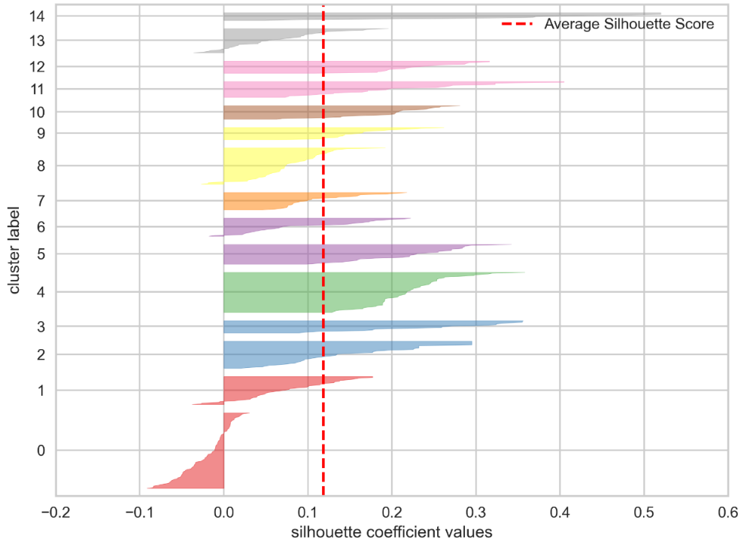
3. Analyzing the Clustering Density
It can be inferred that the tweet clustering using 15 clusters using cosine distance is adequately optimal
Notes:
After we know the content, i also would like to evaluate more specific about the clustering quality in each cluster based on the density that we can calculate them from silhouette index.
The silhouette index is ranged from -1 to 1. The index that close to 1 provides good quality, and vice versa. Meanwhile if it is close to 0 indicates overlapping cluster.
Based on this graph, we can infer that 15 clusters with cosine distance is adequately optimal. Because most of the cluster quality have positive value. As you could see in this graph, X axis is silhouette value and Y axis is the clusters, If the indices tend to be plotted on the right side of 0 value, it indicates the positive number.

Slide 9
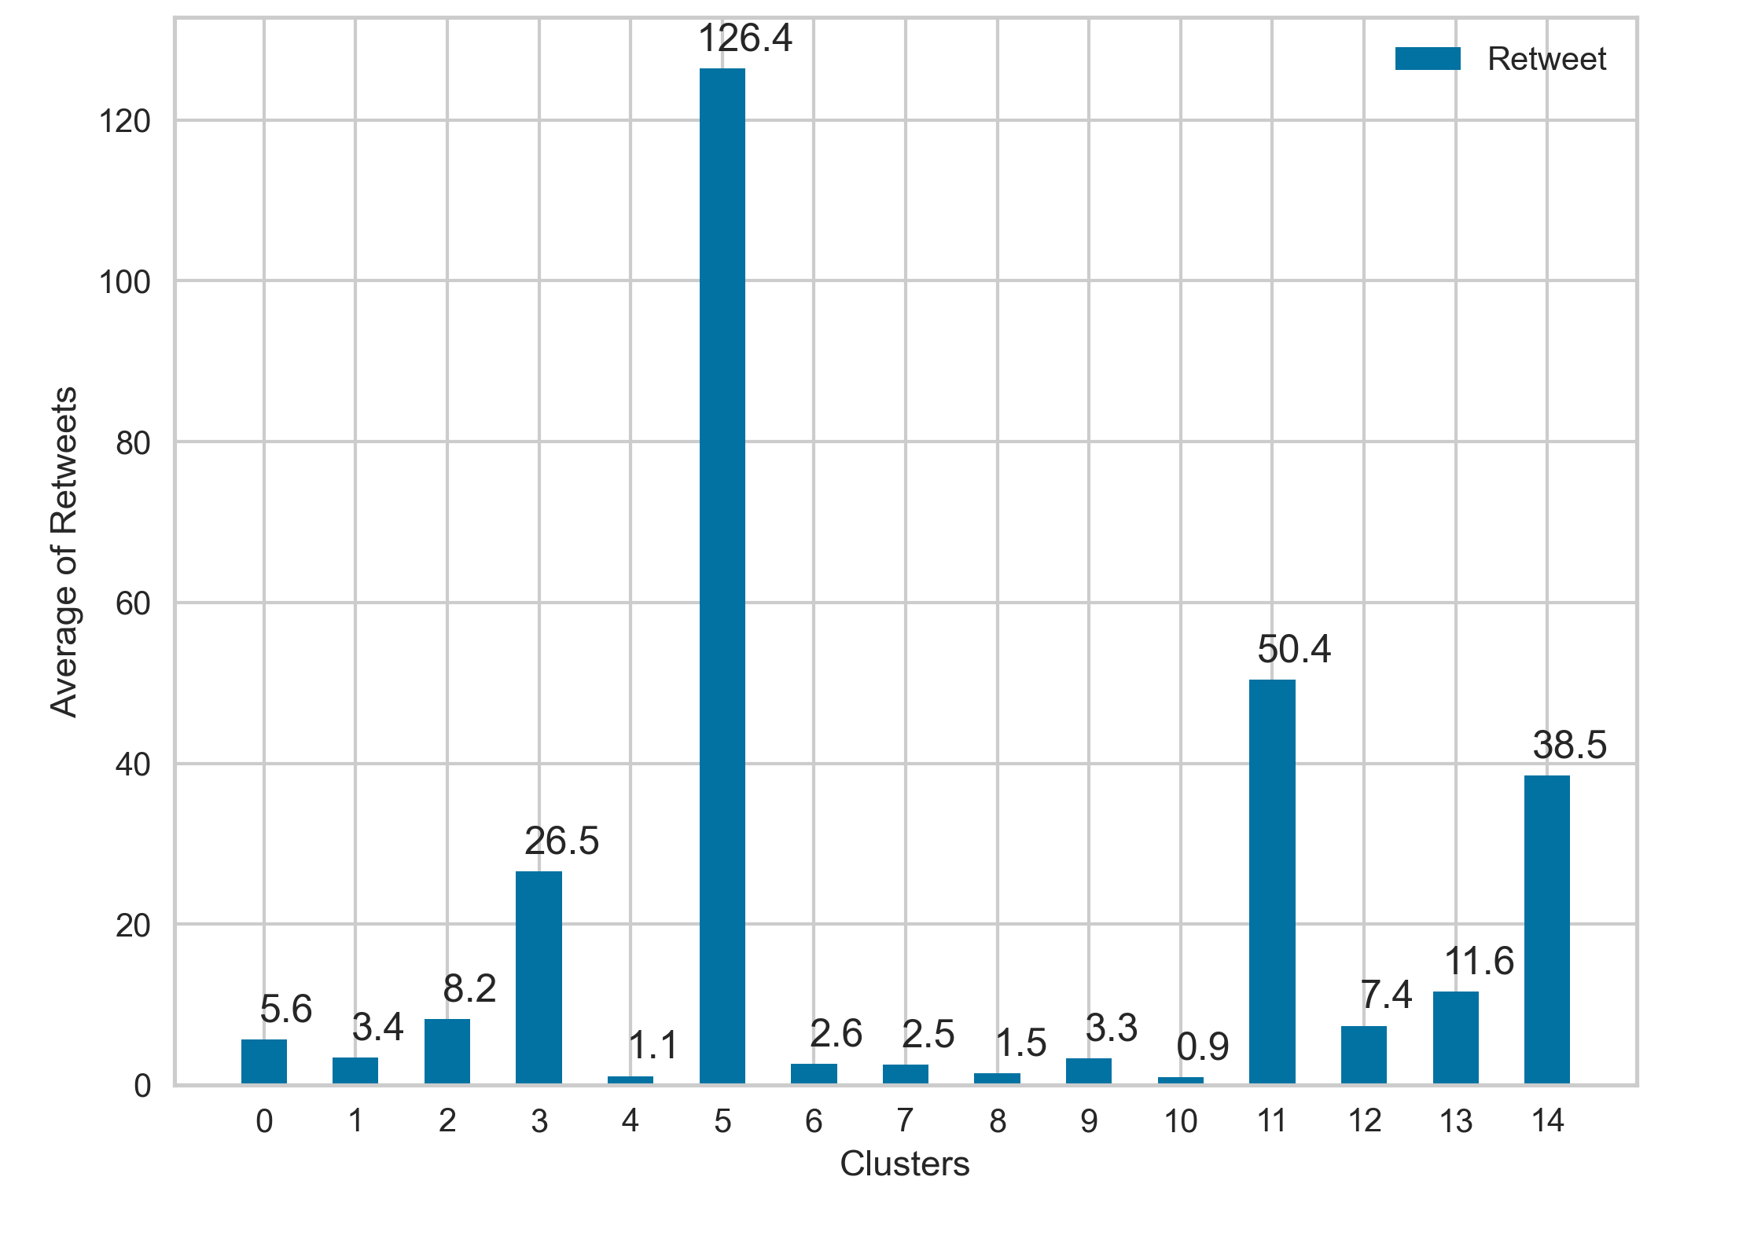
4.
Determining the tweet contents for social media marketing strategies of Blibli
The highest average retweets of the content clusters are :
Cluster 5 : the prizes quiz program in event “Fun with Blibli”
Cluster 11 : fans party through the event called “Hysteria with ParkSeoJun”
Cluster 14 : the collaboration of Blibli, Samsung, and BTS
Notes:
After we know the content clusters, we find the contents that need to be focused by Blibli for employing the precise marketing strategies based on the highest average retweets in each content.
Because retweets can be represented as a content effectiveness and also as measure of the popularity of social media content.
we might say that average retweets from retweet count can also be represented as the interest level of Twitter users about those tweet contents.
So, from that visualization the most preferable content is about cluster 5, ll, and 14. Because those contents have the highest retweet among others.

Slide 10
Conclusion
Most of Twitter user, prefer the contents about quiz programs & collaboration of Blibli with south korean artist (cluster 5, 11, 14), rather than the contents about promo, discount, and cashback offers (the remaining clusters)
Blibli should be focusing on cluster 5 & maximizing that tweet content as its marketing strategy on Twitter.
For future works, it can be inferred that the combination of k-means and silhouette with cosine distance shows the optimal result for text clustering problem.
Notes:
Finally, we jump into end of all sections which is conclusion.
Based on the results, most of Twitter user, prefer the contents about quiz programs & collaboration of Blibli with south korean artist (cluster 5, 11, 14), rather than the contents about promo, discount, and cashback offers (like the remaining clusters)
From that, Blibli should be focusing on cluster 5 & maximizing that content as his marketing strategy on Twitter
For future works, the combination of k-means and silhouette method using cosine can be used for text clustering problem because that combination provides optimal result.

Slide 11
Thank You
Notes:
Oke that’s enough from me, thank you!

